Slide 1






Let's save THE F**king world!!!!!!
GOOD
EMPIRE
Notes:
Welcome everyone my name is Risan and We are team good empire…
(challenge): Our challenge is to build a strategy that would enable Good Empire to gather, unite and empower 1 million uni students around the world to help save the f**king world.

Slide 2

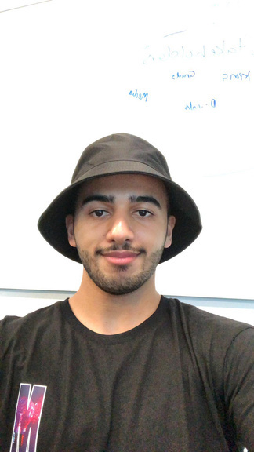
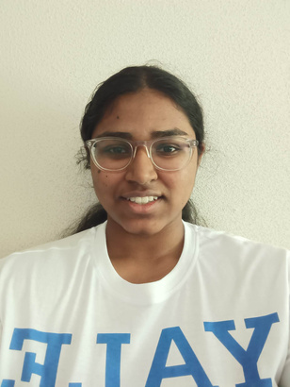
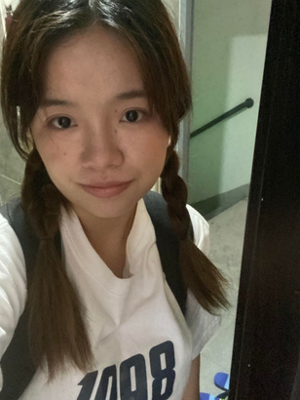

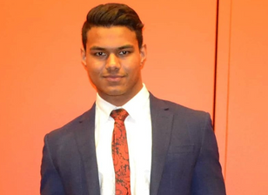



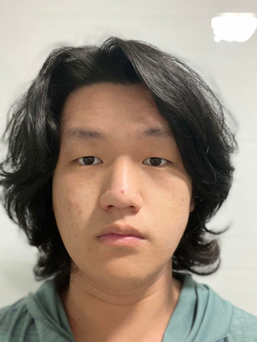
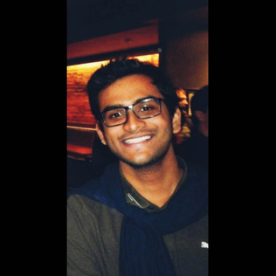
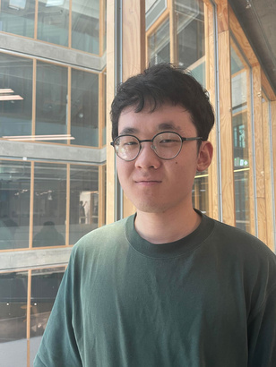
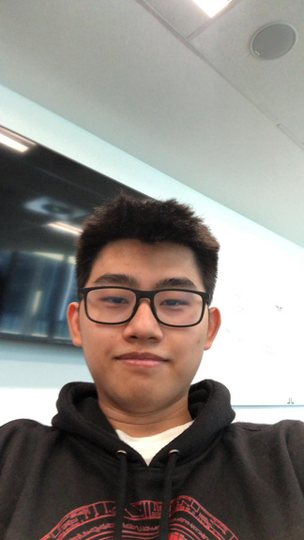
MOHAMED
AL-MAQBALI
NETHMI AMARASIRI
YAWEN
LIU
EVELYN
TRAN
RANJIT
RAJA
Business Administration
Business
Science
Law & IT
Commerce & IT
RISAN
YOOSEF
XI
CHENG
ARITRO
DUTTA
DAVID
PU
JUSTIN
LIMAR
Biomedical Science
Marketing
Software Engineering
Pharmaceutical Science
Biomedical Science

Slide 3

UNITE
GATHER
EMPOWER
Notes:
Image 1a: https://i.pinimg.com/564x/be/3d/18/be3d1821e8d43828375a76863a08b6bf.jpg
Image 1b:
https://i.pinimg.com/474x/e6/c9/7c/e6c97c495a49119865318a6cfc8c56d4.jpg
so when I first looked at this challenge, the first thing that came to my mind was ‘ what have I done for the world’ and I encourage you to think about this as well. How many times have we heard the same story again and again and yet everytime nothing is done about it. Now this does this not just apply to us.

Slide 4



THE PROBLEM?
Students
Universities
Good Empire
Results for 17 SDGs
Item 3
33.3%
WHY
WHO
Item 1
33.3%
UNITE & EMPOWER 1M UNI STUDENTS TO SAVE THE F**KING WORLD
Strong community &
Measurable Impacts
HOW
Item 2
33.3%
Notes:
(mapping diagram): So how can we change this? How can we build something that all these platforms and cooperations have not and build something that actively builds consistent results for the sdgs. To break this problem down, we drew a problem diagram map. So There are many ways to look at this such as purpose or why of this problem as well as how this problem is rooted to the social aspect of society but we really wanted to focus from the stakeholders perspective and really find a solution that will benefit all these major parties which is the university, students and good empire.

Slide 5


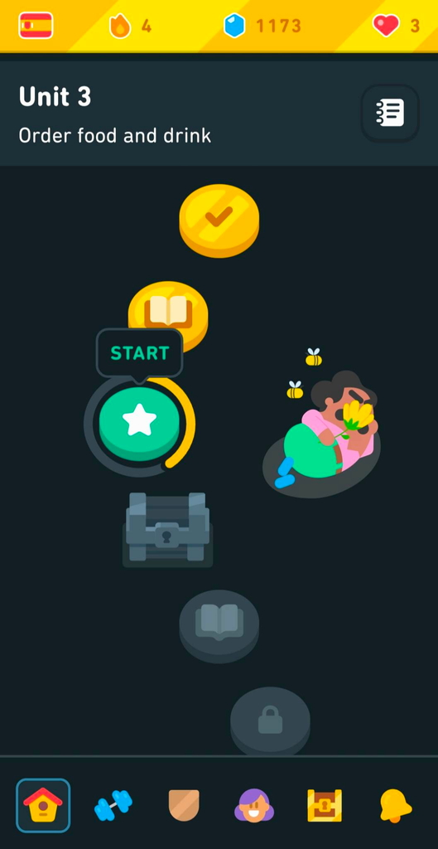



OTHER MODELS
(Yang 2017)
(Thomas 2018)
MyMaccas
MyFitness
Doulingo User Interface
Pokemon Go
Duolingo
(Bitrián, 2021)
Notes:
- The app doesn't have a large user base and we need to increase our reach
- Uni students lack of motivation and attention span
Approaching this challenge, we outlined a number of problems that we had to consider.
in its current state, the app doesn’t have a large user base, especially not within the university cohort, So we propose communicating with faculties & societies to get them on board and increase our reach within uni, and setting up QR codes will increase awareness towards the app.
but the major players, in terms of uni students, are the lack of motivation as well as the attention span. Think about the current apps that are popular and can maintain a user base.
Apps like Pokemon Go offer in-game rewards like virtual currency, similarly, Duolingo uses gamification techniques like daily challenges and streaks to encourage continuous use. Apps like MyFitness or MyMaccas provide real-world incentives like discounts and cashback rewards after hitting a certain milestone.
And so knowing the power that incentives can have, our solution involves a combination of clever marketing alongside an incentive model.

Slide 6

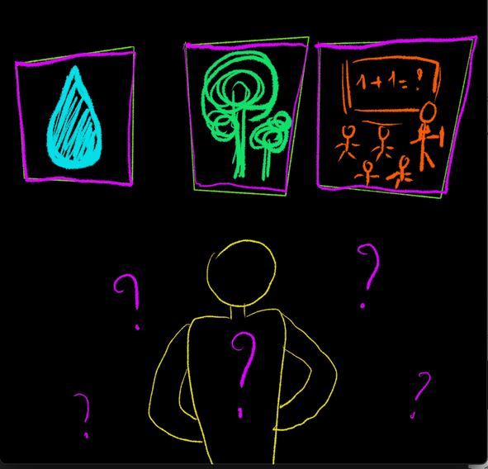
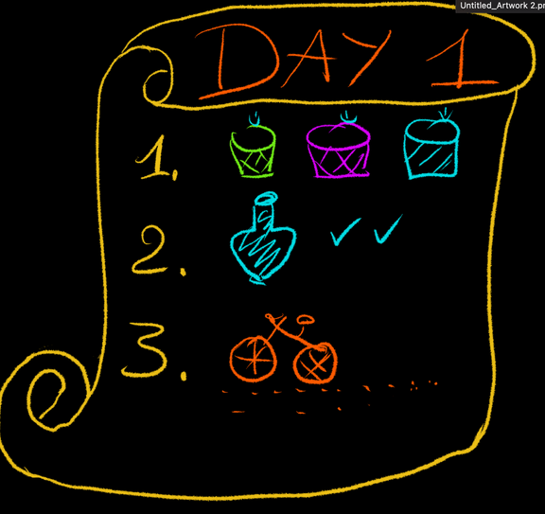
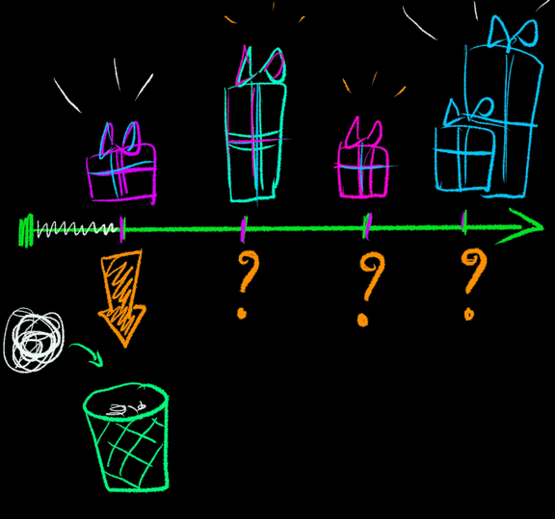
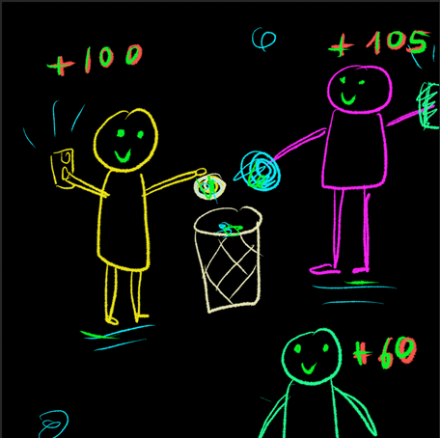
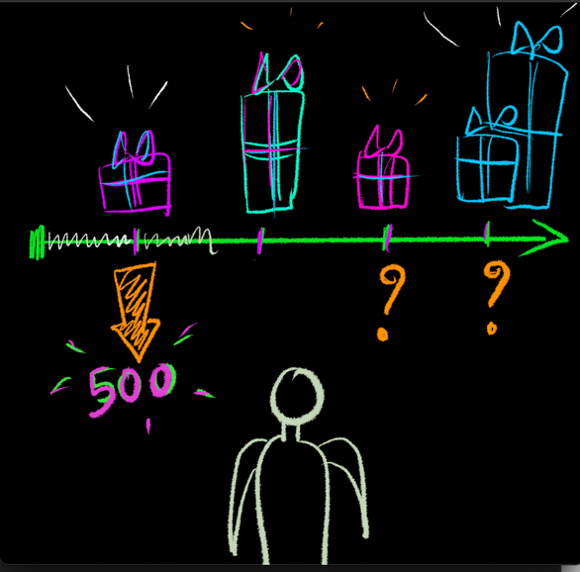
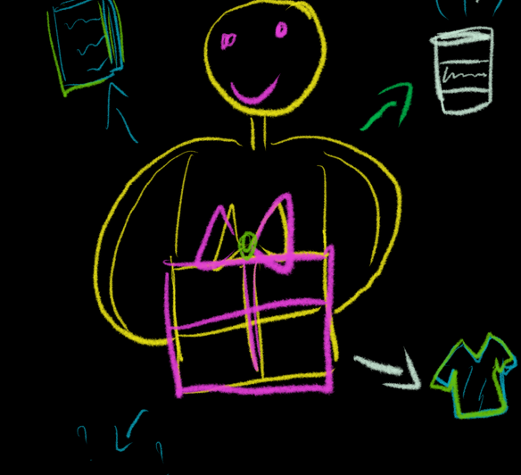
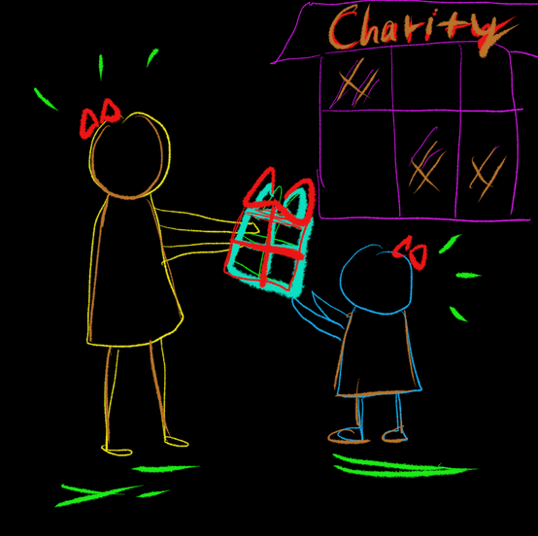
1
2
3
4
SCAN
CHOOSE
CURATE
GOALS
5
6
7
8
EARN
PROGRESS
REWARD
DONATE
Notes:
And so knowing the power that incentives can have, our solution involves a combination of clever marketing alongside an incentive model.
-this is how our model will work, because of our initial marketing, there will be some Good Empire presence within the uni, whether from word of mouth, emails or QR codes. Youll download the app, maybe out of pure curiosity, and will be presented with a list of SDG’s with some information about them, youll pick one that interests you and a list of relevant challenges will be given to you. Youll also be able to see some milestones that you can begin working towards. As you complete challenges, youll earn points which will contribute to your milestones. Reaching one will earn you a reward, either virtual or real-world. You can also choose to exchange that reward as a donation

Slide 7


Increase user base
Good Empire
Vendors
More Customer
Additional revenue stream
MONASH UNIVERSITY
Reputation
Student Traffic
Others
Students
Receive discount coupons

Slide 8
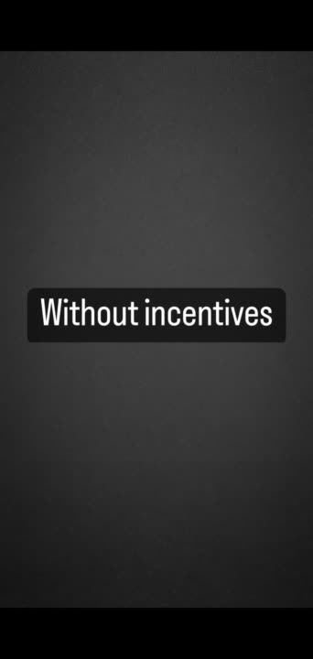

PROTOTYPE
WITHOUT INCENTIVE
(Atem, 2019)

Slide 9
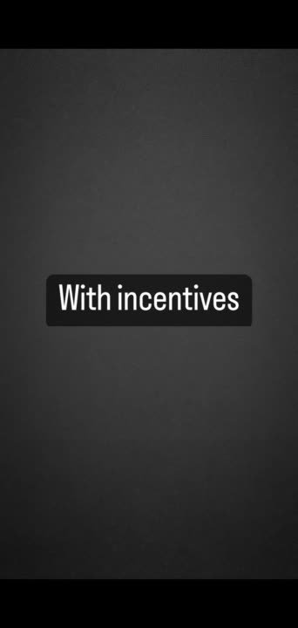

PROTOTYPE
WITH INCENTIVE
(Tridas, 2021)
(Anderson, 2017)

Slide 10



INSIGHT AND IMPROVEMENT
1
Lack of Education
2
Too Difficult
3
No Action
(Neil, 2018)
(Blumberg, 2013)

Slide 11

SOME STATS...
No Incentives
(15%)
Positive Impacts
(8%)
Social Aspect
(28%)
IF...?
WHY WOULD YOU DO IT?
Figure 1: Incentives vs No incentives
Incentives
(85%)
Incentives
(64%)
Figure 2: Motives

Slide 12

Item 3
33.3%
Item 1
33.3%
EDUCATION
INCENTIVES
RECOMMENDATION
SOCIAL ASPECTS
Item 2
33.3%

Slide 13

CALL TO ACTION

Slide 15


HANNAH
KIM
ANDRÉ
EIKMEIER
Internal Communications Manager
at Monash
CEO and Founder of Good Empire

Slide 16
REFERENCES
Campus Sustainability. (n.d.). Campus Sustainability. https://www.monash.edu/campus-sustainability
Sustainability. (2019). Www.scimagojr.com. https://www.scimagojr.com/journalsearch.php?q=21100240100&tip=sidbility.unimelb.edu.au/
Take action to protect the environment | Greenpeace. (n.d.). Greenpeace Australia Pacific. https://www.greenpeace.org.au/how-we-work/act/
Bitrián, Paula, Buil, Isabel, & Catalán, Sara. (2021). Enhancing user engagement: The role of gamification in mobile apps. Journal of Business Research, 132, 170–185. https://doi.org/10.1016/j.jbusres.2021.04.028
Yang, Yang, Asaad, Yousra, & Dwivedi, Yogesh. (2017). Examining the impact of gamification on intention of engagement and brand attitude in the marketing context. Computers in Human Behavior, 73, 459–469. https://doi.org/10.1016/j.chb.2017.03.066
Hossain MS, Zhou X, Rahman MF. Examining the impact of QR codes on purchase intention and customer satisfaction on the basis of perceived flow. International Journal of Engineering Business Management. 2018;10. doi:10.1177/1847979018812323
Andersen, T. J. (2017). The Responsive Global Organization : New Insights from Global Strategy and International Business.
Blumberg, M. (2013). Startup CEO : A Field Guide to Scaling up Your Business. (1st ed.).
Adler, J. (2013). Examining contributions to a corporate microblog as a basis for an employee incentive system. Anchor Academic Pub.

